Slide 1


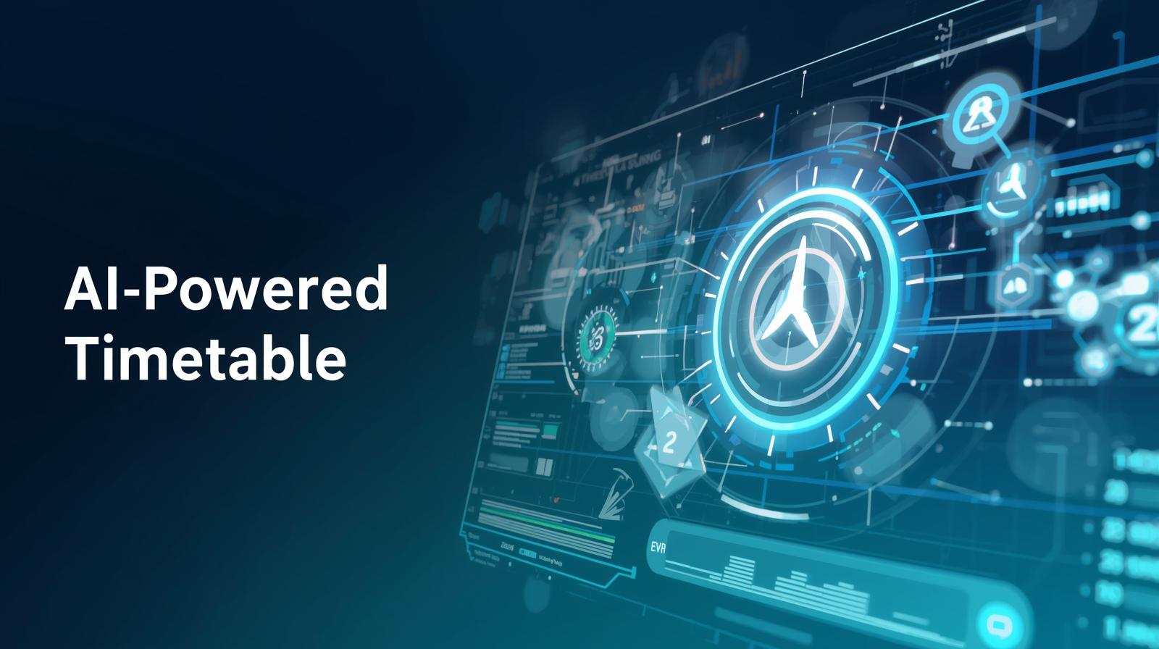
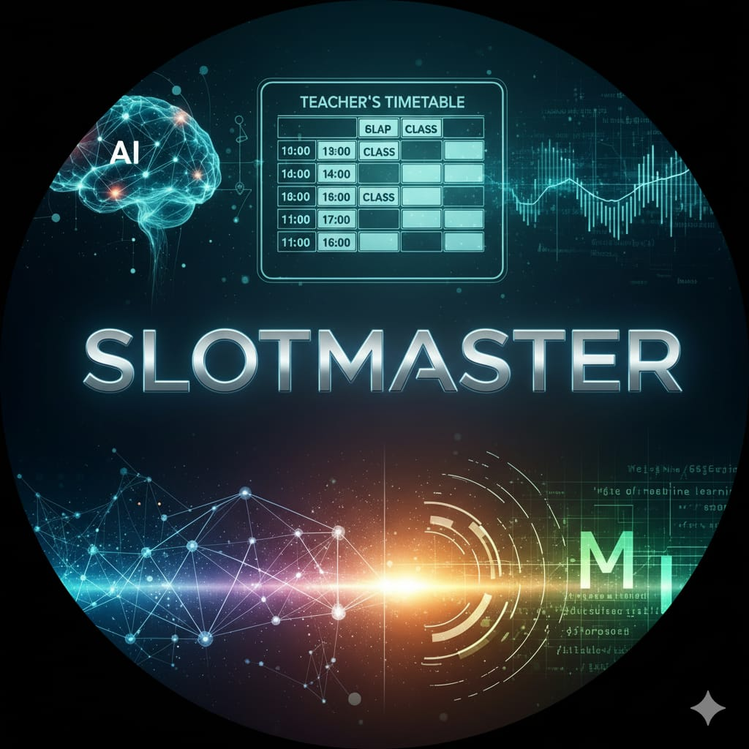
SMART INDIA HACKATHON 2025
TITLE PAGE
Problem Statement ID – SIH25091
Problem Statement Title- AI-Based Timetable Generation Systemaligned with NEP 2020 for Multidisciplinary Education Structures
Theme- Smart Automation
PS Category- Software/Hardware: Software
Team ID-SR2633
Team Name (Registered on portal) - SlotMasters

Slide 2
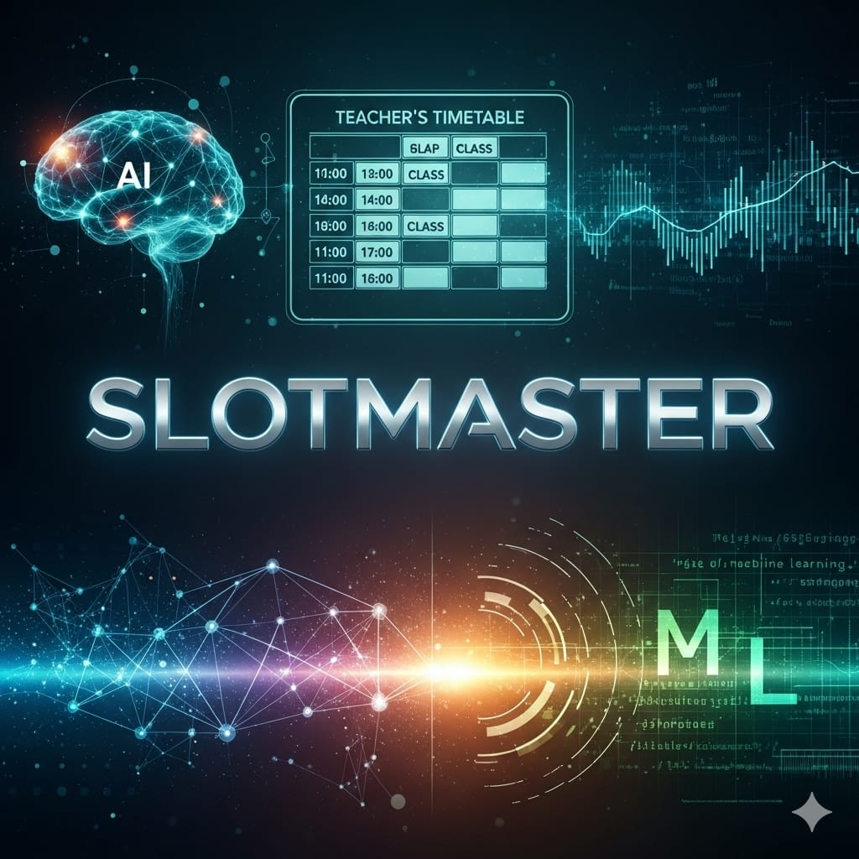



IDEA TITLE
How it address the problem ??
Eliminates manual errors and conflicts (same teacher/room assigned twice)
Detailed explanation of proposed solution
An *AI-based timetable generator* that automatically creates optimized schedules for schools, colleges, or universities in line with *NEP 2020*.
Supports *multidisciplinary education* (students can choose courses across departments).
Handles constraints teacher availability, room capacity, labs, electives, multidisciplinary subjects, workload balance, etc.
Reduces manual effort and ensures conflict-free schedule ,teacher course schedule unit wise schedule.
Saves time and effort compared to manual scheduling.
Ensures fair workload distribution among teachers
Provides flexibility for quick updates when changes (e.g., leave, extra classes) occur.
AI-driven break optimization (no long idle gaps, balanced sessions).
Student-centric design: considers psychology, attention span, and feedback.
Can integrate with attendance, feedback, and performance data for adaptive scheduling.
Innovation
Uniqueness
&

Slide 3


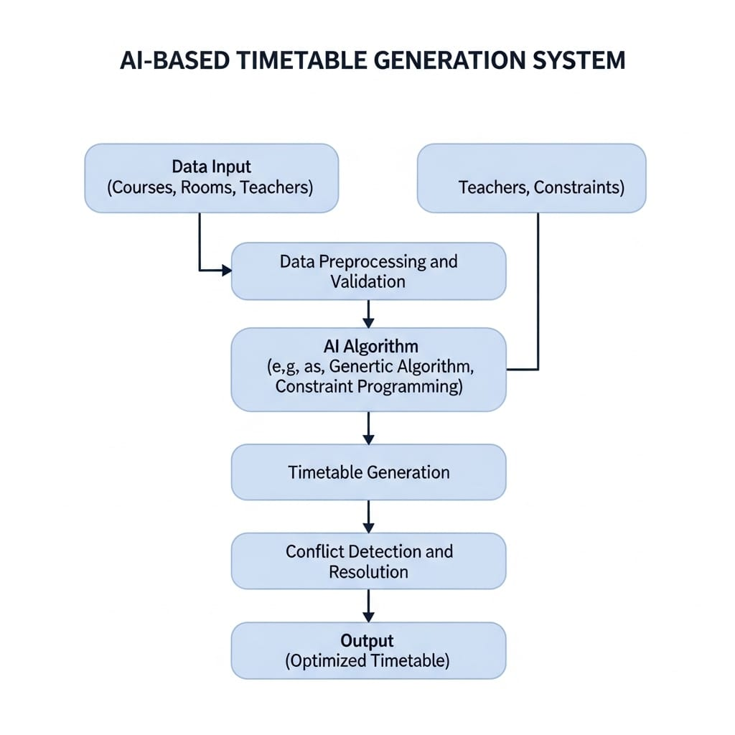
TECHNICAL APPROACH
Flowchart
Technologies
AI & ML
Constraint Algorithms
Fronted (html, css, js)
Backend (Django, React)
Python / Java
Django / Flask
React / Angular
MySQL / MongoDB
Cloud Platforms

Slide 4
FEASIBILITY AND VIABILITY
Strategies
Potential Challenges and risks
Managing complex scheduling constraints
Integrating with existing systems
Ensuring data privacy and security
Handling sudden changes in schedules
Risk of AI generating conflicts
User resistance to automation
System reliability and maintenance
Maintain system regularly
Integrate smoothly with existing systems
Implement data security measures
Enable real-time schedule updates
Validate AI-generated timetables
Use AI optimization algorithms
Feasibility analysis
Technical:
AI can generate optimized schedules
Scalable:
Works for multiple courses and departments
Legal:
Must protect student/staff data.
Economic:
Saves time and resources; cost-effective
Operational
Reduces manual work; handles changes easily

Slide 5





IMPACT AND BENEFITS
Social:
Reduced stress, fair workload, better learning outcomes
Educational:
Improved teaching efficiency, personalized schedules, smooth operations
Environmental:
Paperless scheduling, energy saving, eco-friendly campuses
Economic :
Cost savings, efficient resource use, higher productivity
Technological:
AI-driven automation, real-time updates, scalable system
Students –
Personalized schedules, real-time updates
Teachers –
Smart substitution, conflict-free planning
Institutions –
Predictive analytics, LMS integration
Parents –
Transparency, instant notifications
Academic:
No clashes in subjects, teachers,
rooms
Potential Impact

Slide 6






RESEARCH AND REFERENCES
[Google OR-Tools:Timetabling] (https://developers.google.com/optimization/scheduling/timetabling)
SpringerLink: [AI in Educational scheduling]
(https://link.springer.com/chapter/10.1007/978-3-030-44221-1_14)
[NEP 2020 OfficialPDF] (https://www.education.gov.in/sites/upload_files/mhrd/files/NEP_Final_English_0.pdf)
Burke et al. “Automated Timetabling: The State of the Art
Davison(2024 springer ) – University course timetabaling models & solutions.
References

